Slide 1
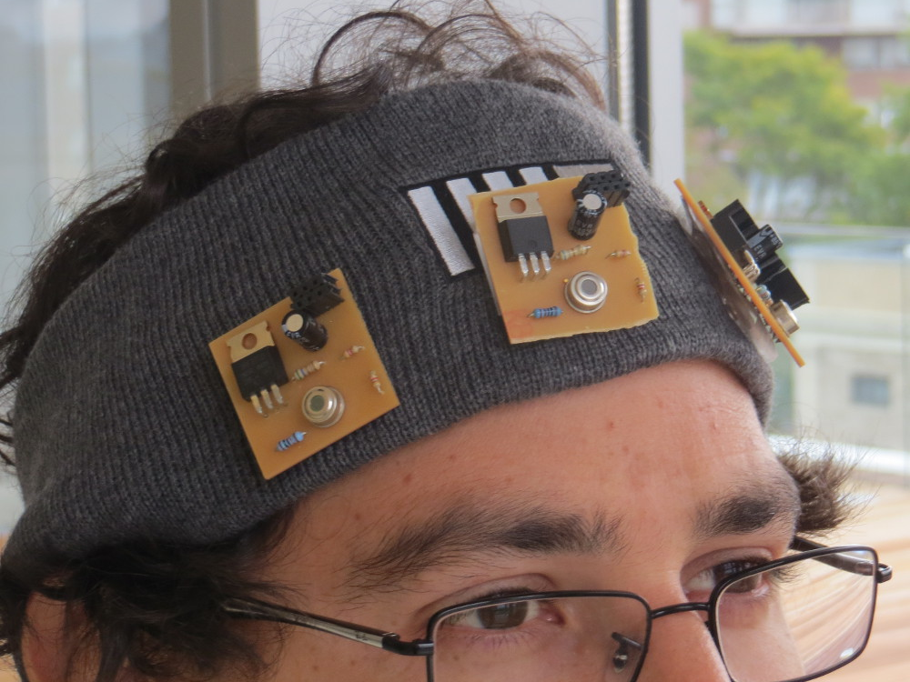
Digital synesthesia
Using Mobile Technology to Interact with Our World
PhD Thesis By:
Santiago Alfaro
Committee:
V. Michael Bove Jr.
Joseph Paradiso
Kevin Slavin

Slide 2
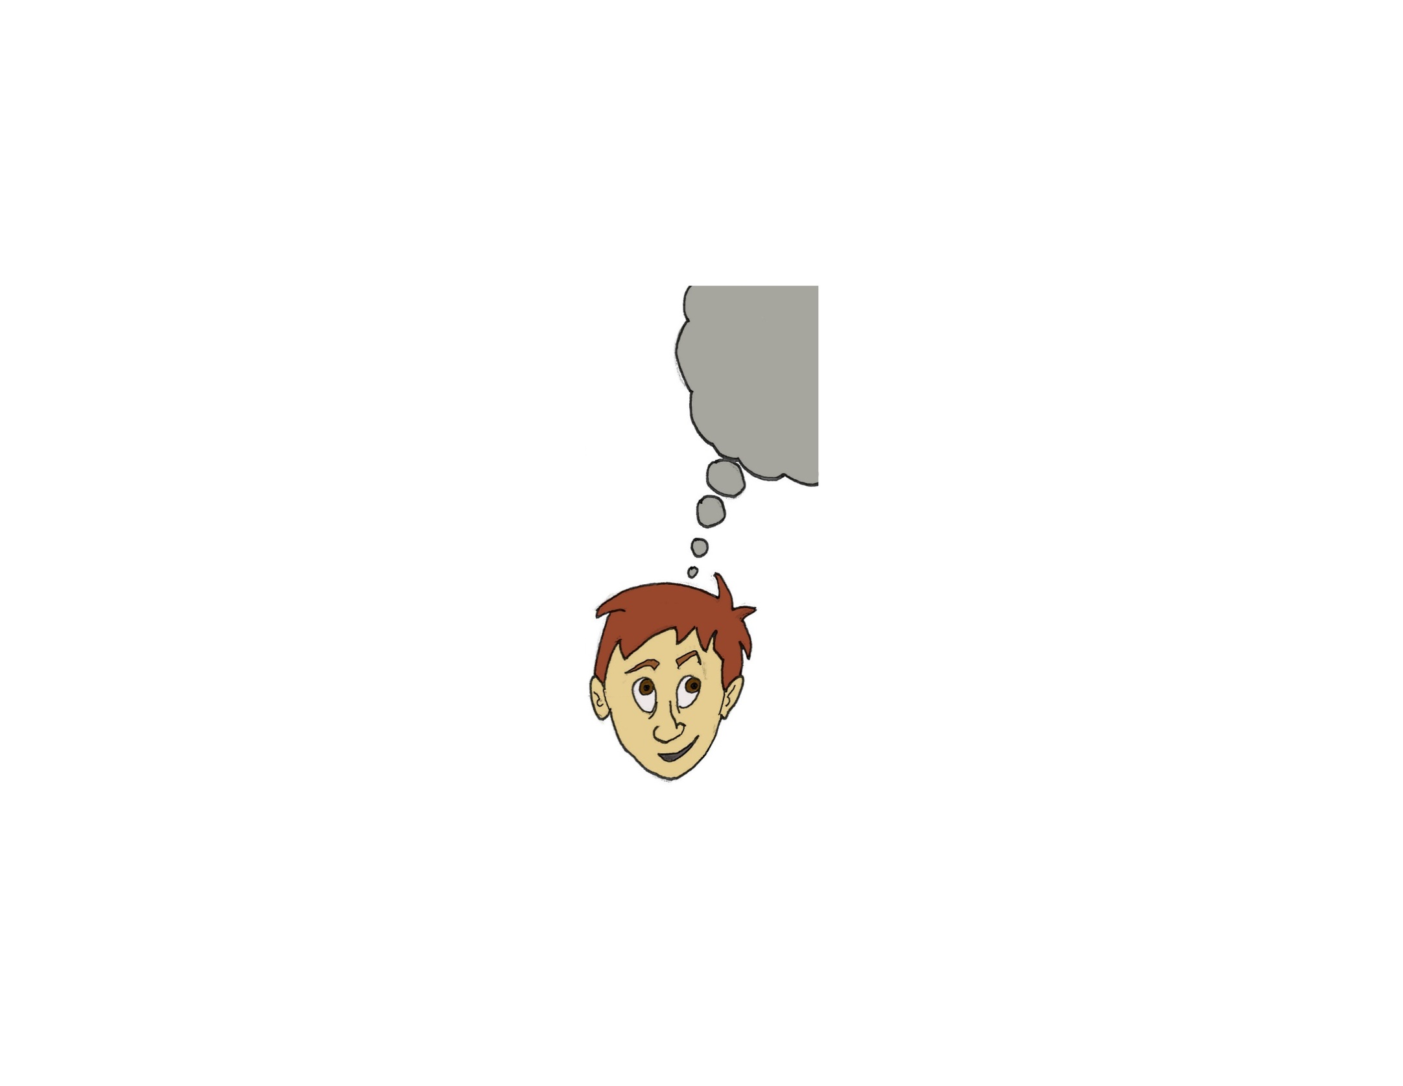
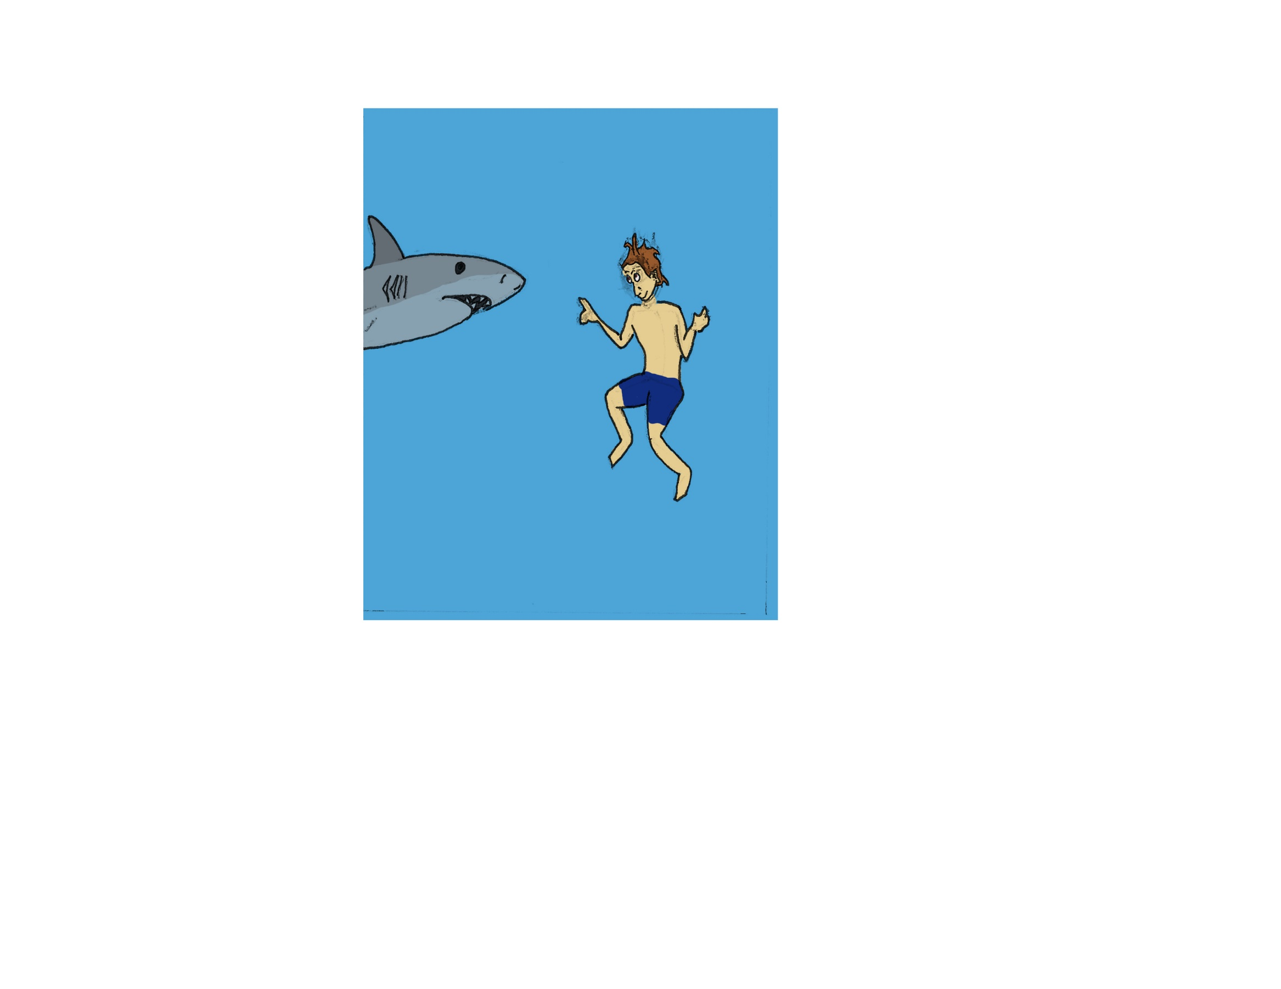
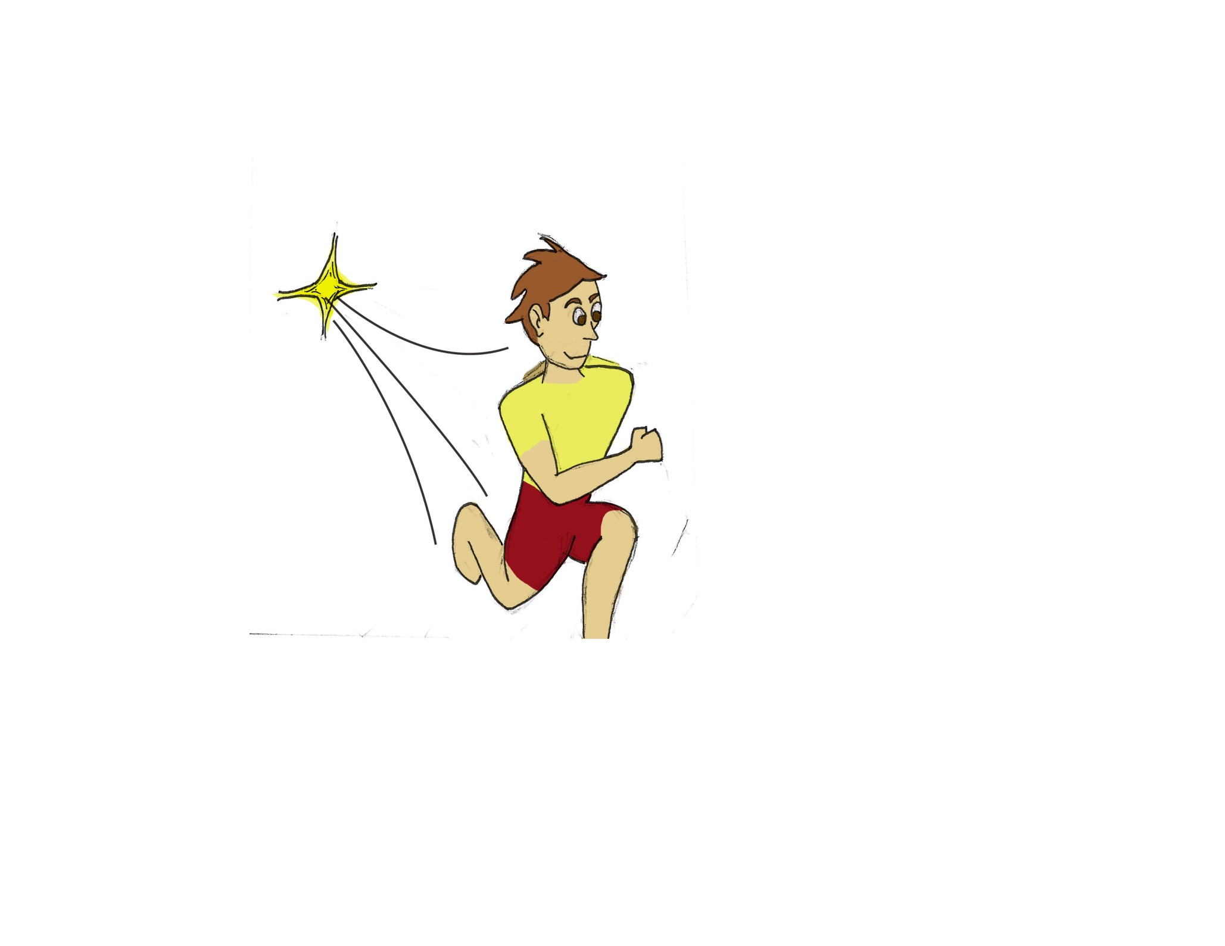
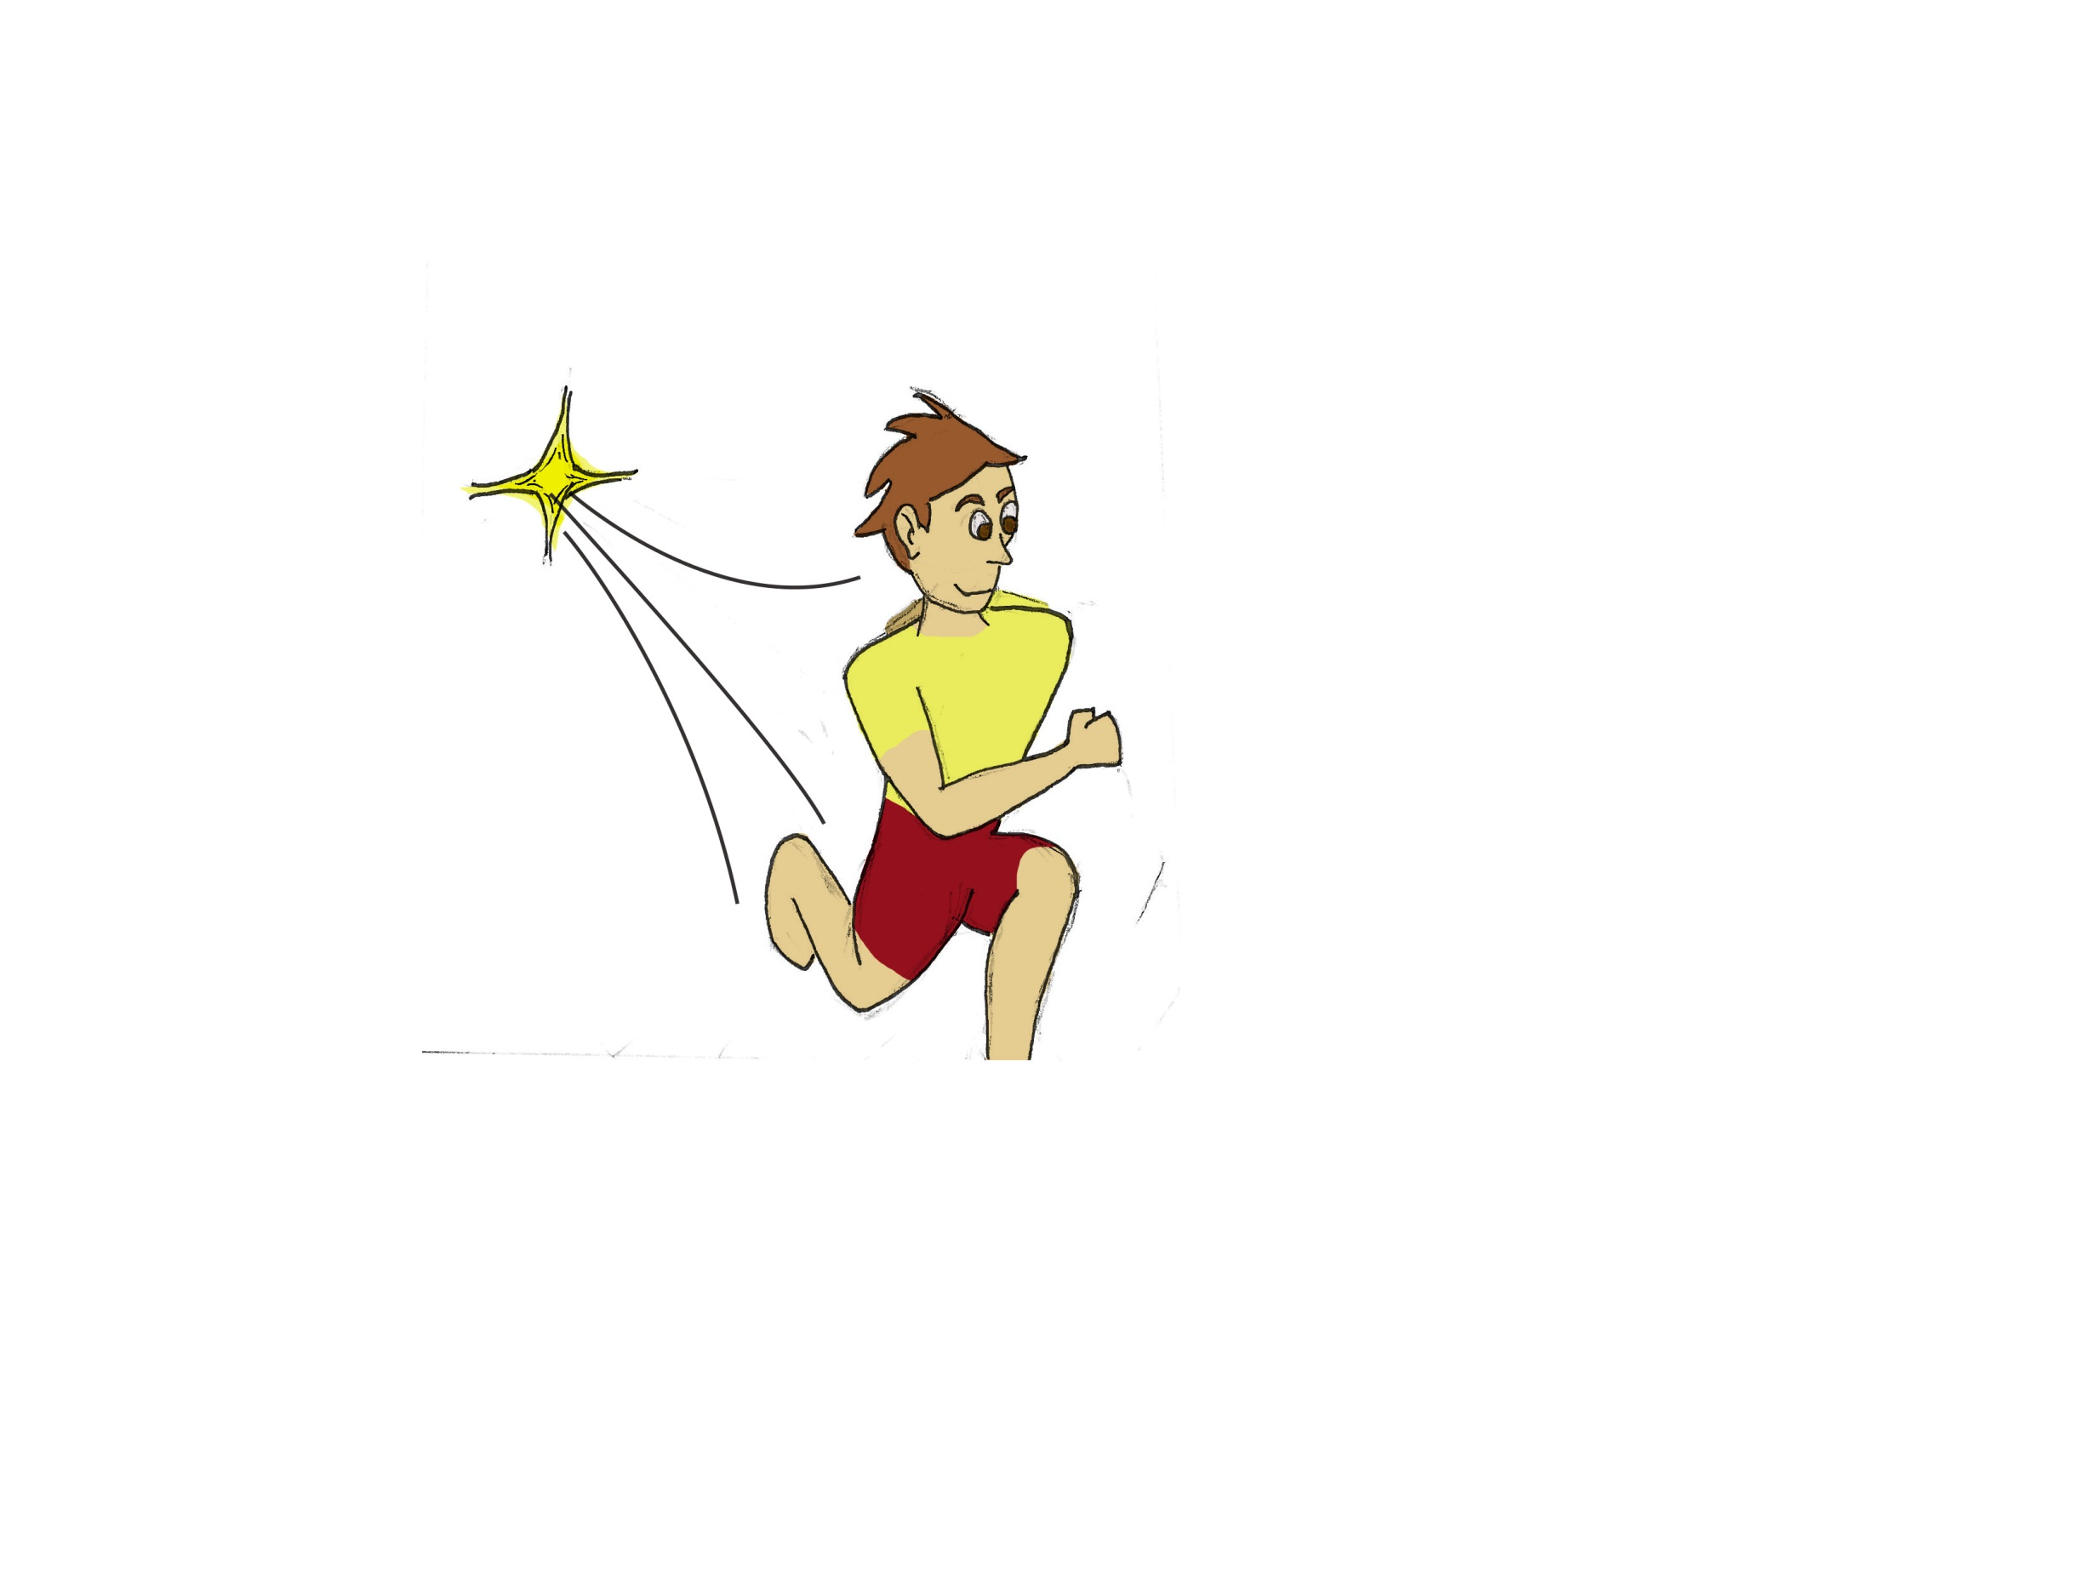

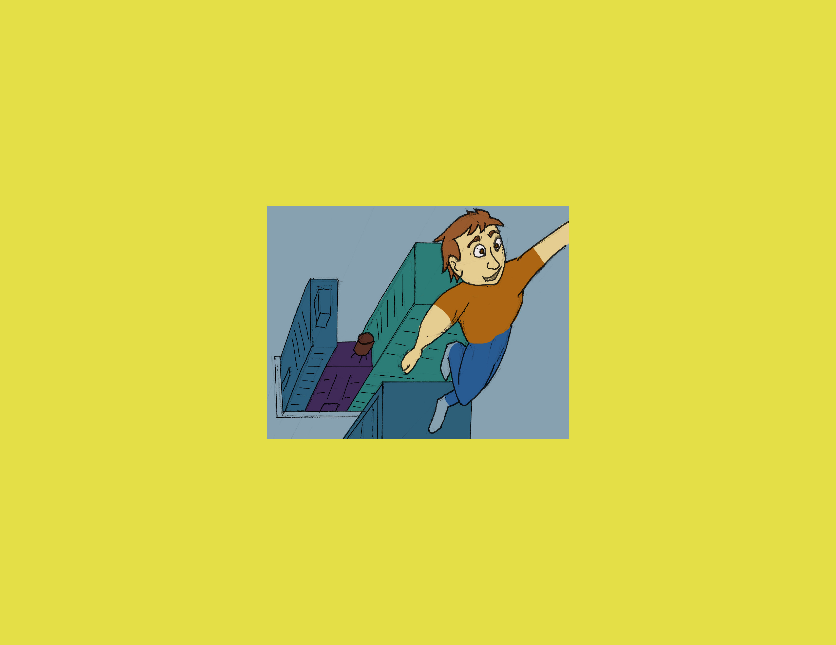
Humans have dreamt of going past our physical capabilities like…
… Breathing under water…
… having super-human Speed…
… or flying.
… going to space…
Notes:
Intro: Dreams:
Dreams - breathing under water – speed – space – flying.

Slide 3
Other dreams are about our senses…
Notes:
Intro: Other dreams dealing with senses
Senses – Sight – sound – porf X – Spidey - Quickening

Slide 4
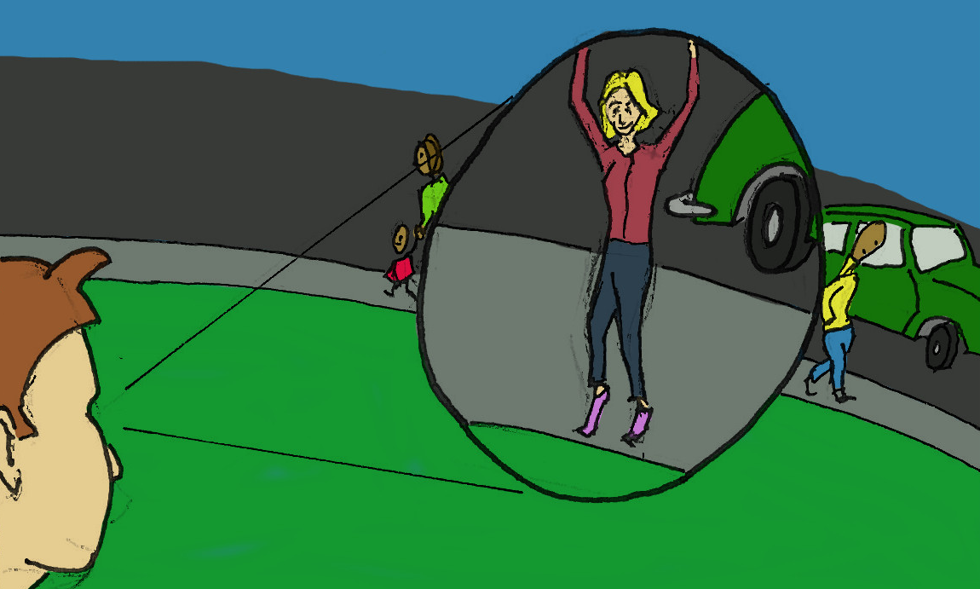
Other dreams are about our senses…
… sight…
Notes:
Intro: Other dreams dealing with senses
Senses – Sight – sound – porf X – Spidey - Quickening

Slide 5
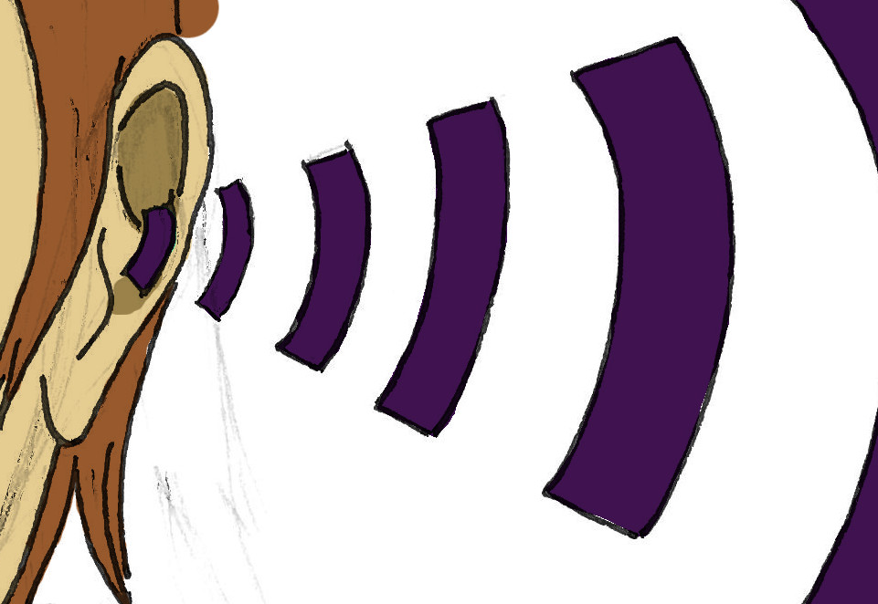
Other dreams are about our senses…
… sight…
… hearing…
Notes:
Intro: Other dreams dealing with senses
Senses we don’t even posess
Senses – Sight – sound – porf X – Spidey - Quickening

Slide 6
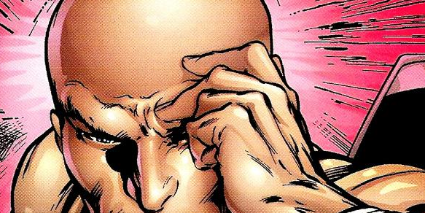
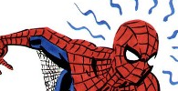
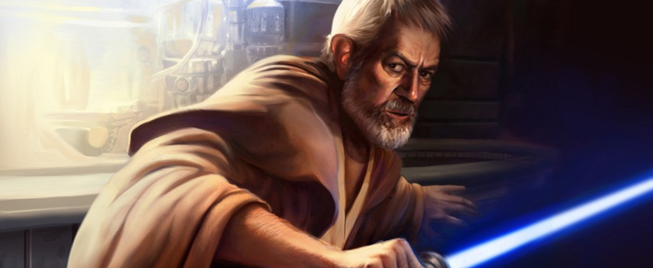
Other dreams are about our senses…
Some are about senses we don’t possess
… sight…
… spidey sense…
… hearing…
… a disturbance in the force.
Notes:
Intro: Other dreams dealing with senses
Senses – Sight – sound – porf X – Spidey - Quickening

Slide 7
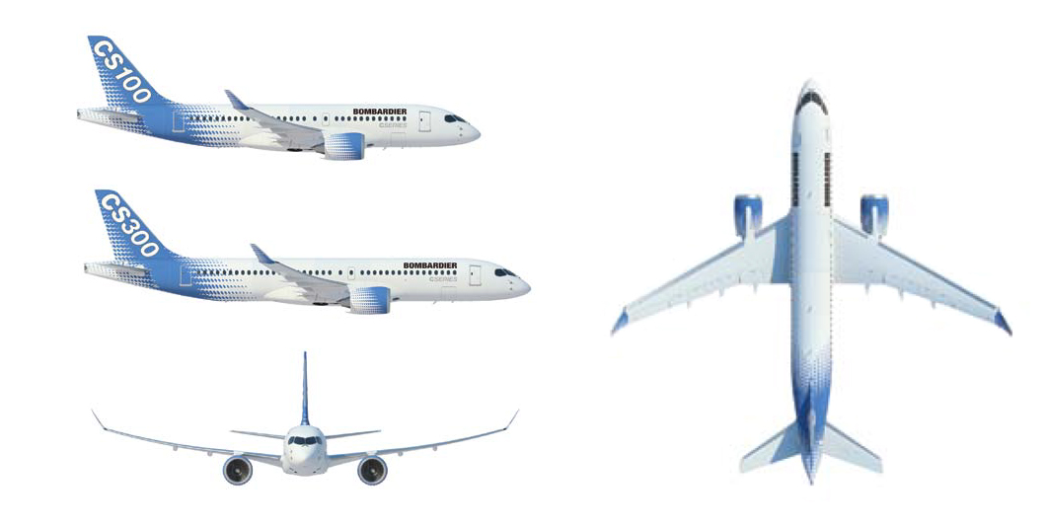
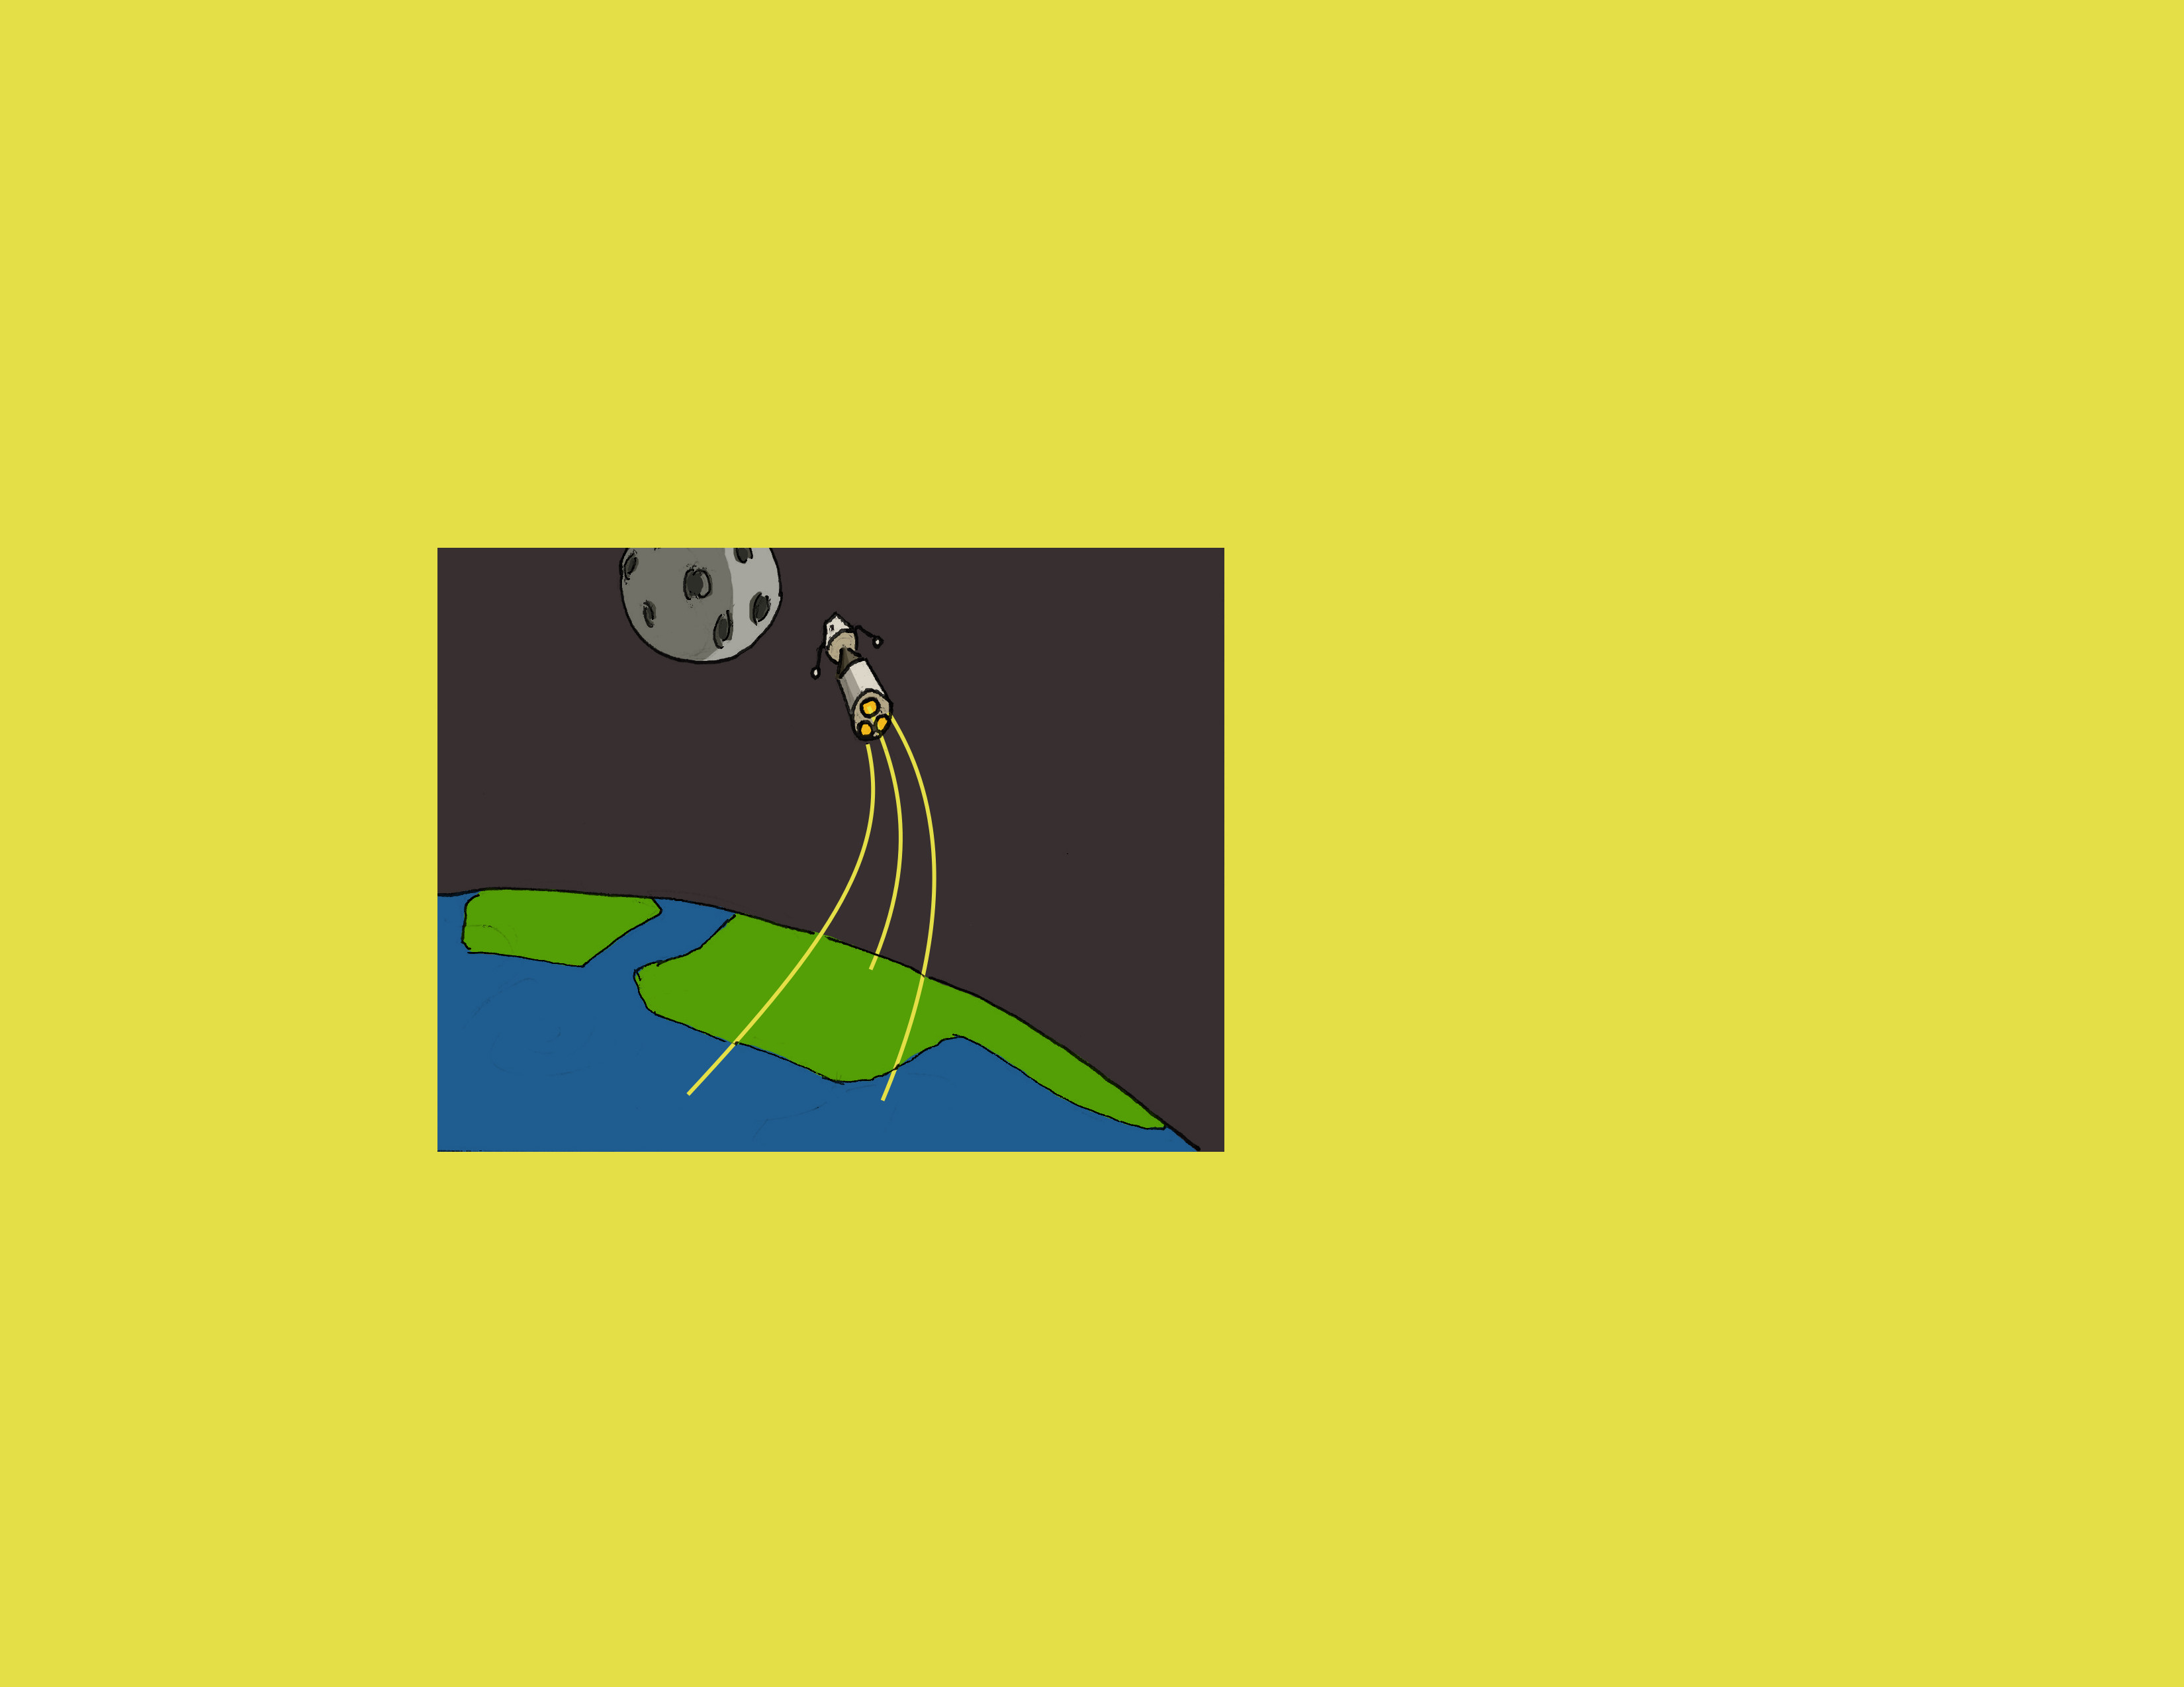
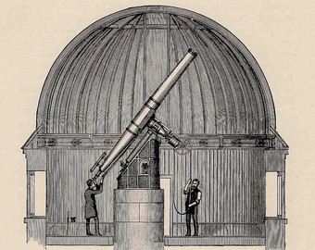
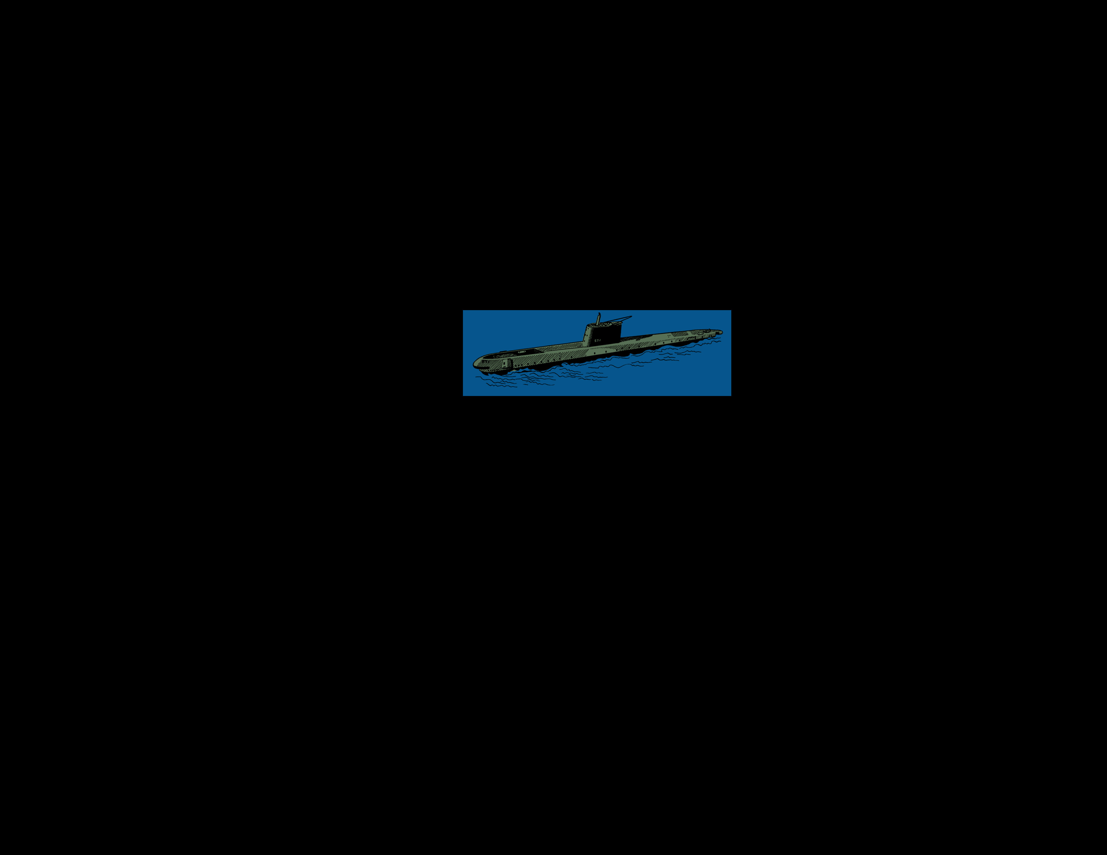

WE have reached some dreams
AND By UNDERSTANDING OUR WORLD
With technology
Notes:
Intro: Technology

Slide 8
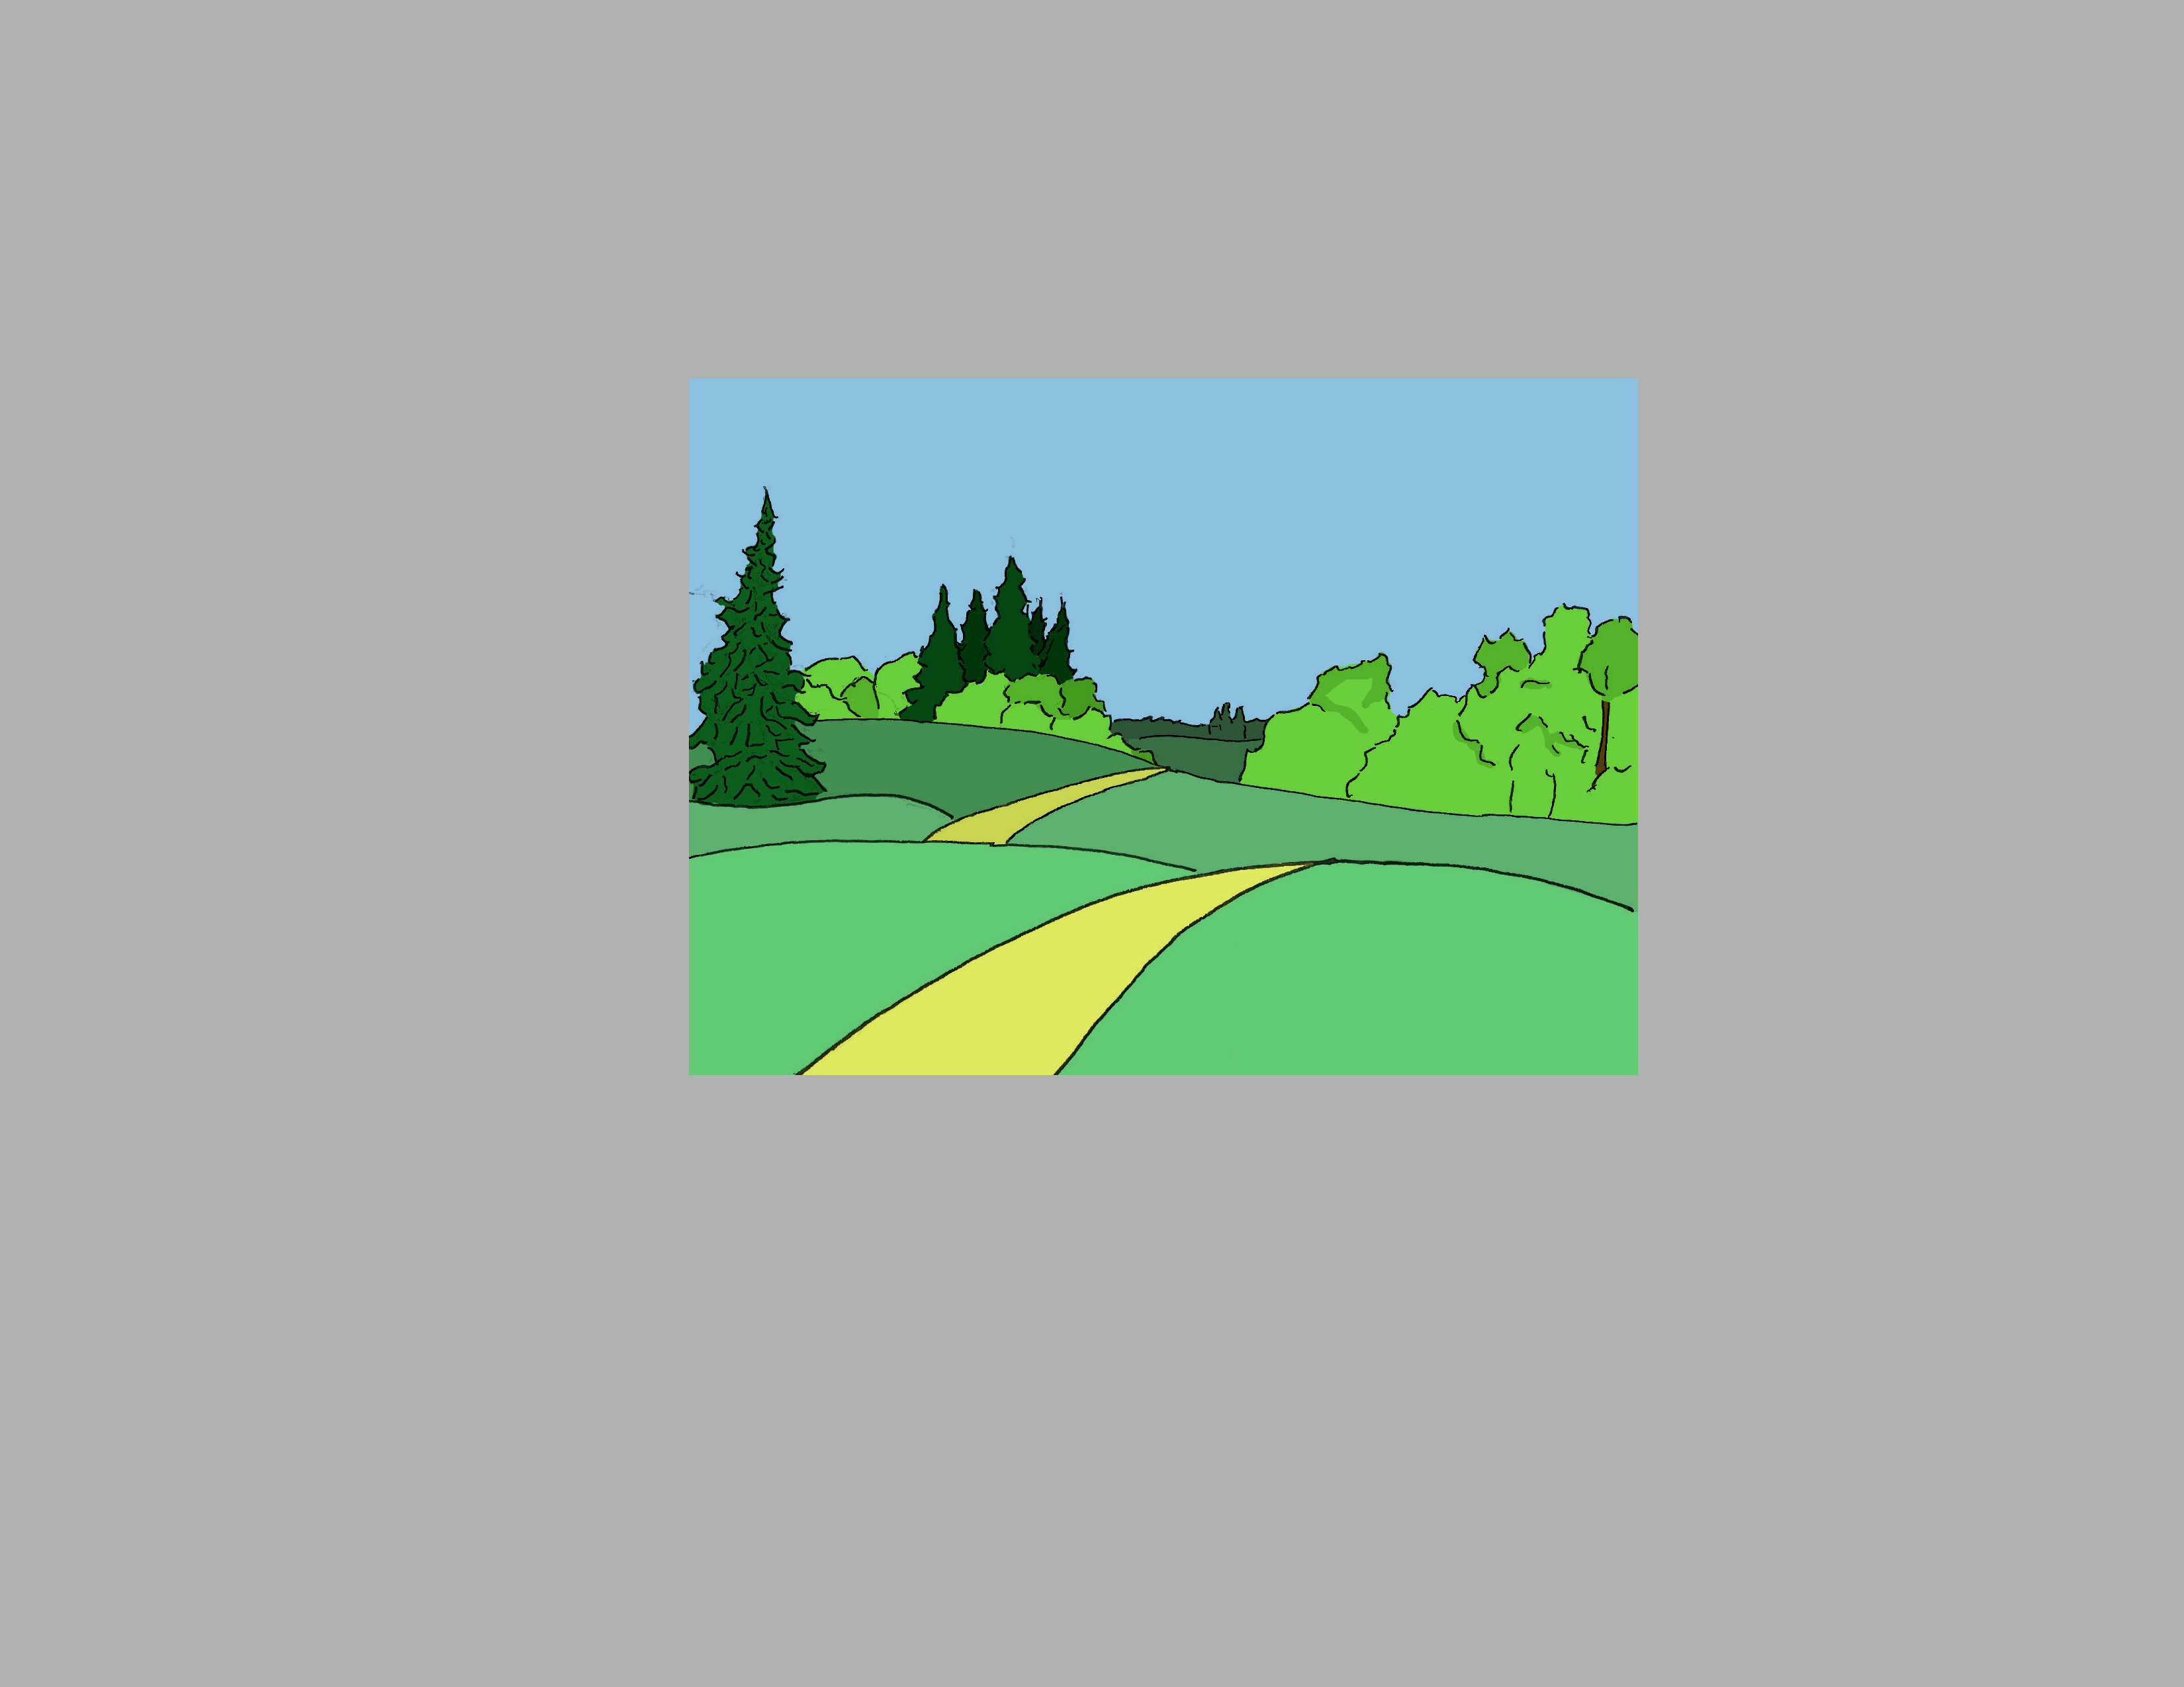
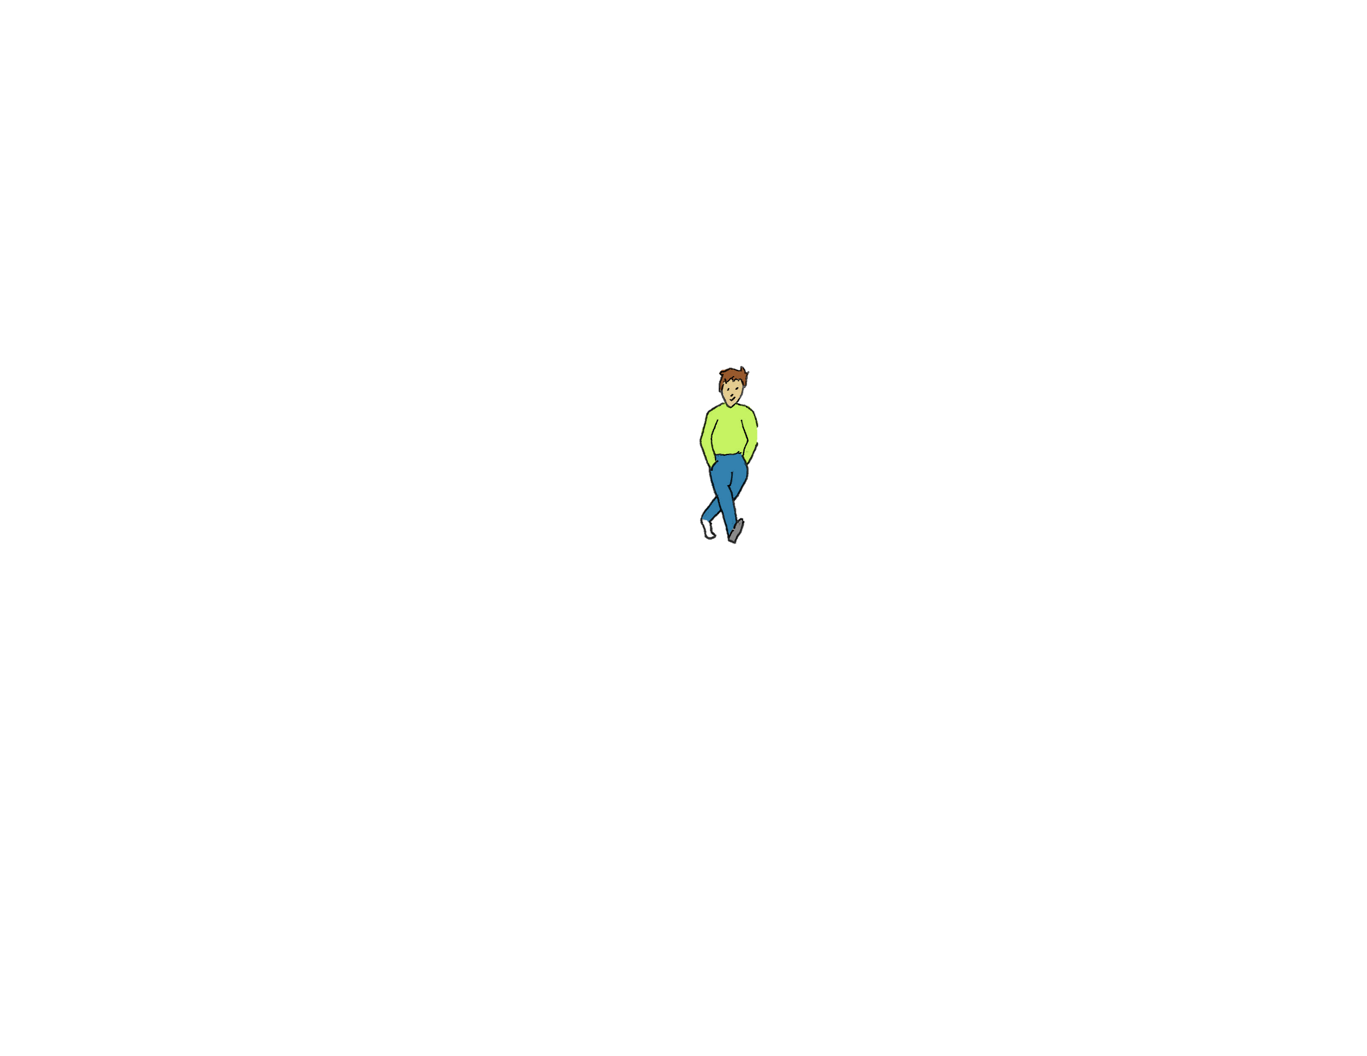
Notes:
Intro: More than we can sense
Our 5 senses – IR – UV – Magnetic Waves – WiFi – Cellphone

Slide 9

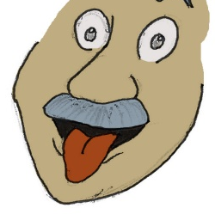

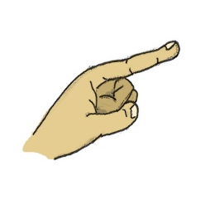
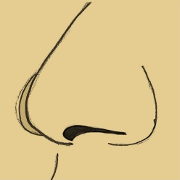
Notes:
Intro: More than we can sense
Our 5 senses

Slide 10

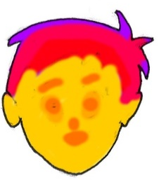

UV Light
IR
radiation
Magnetic fields
Notes:
Intro: More than we can sense
Our 5 senses – IR – UV – Magnetic Waves – WiFi – Cellphone

Slide 11
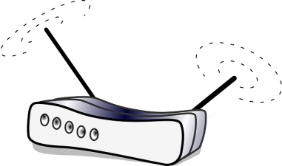
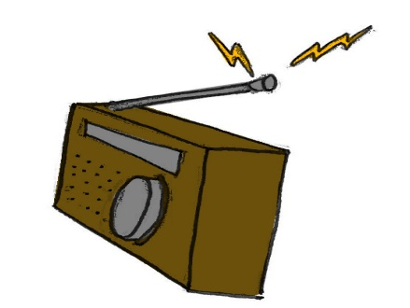
UV Light
WiFi
IR
radiation
RAdio
Magnetic fields
Pollution
Notes:
Intro: More than we can sense
Our 5 senses – IR – UV – Magnetic Waves – WiFi – pollution

Slide 12

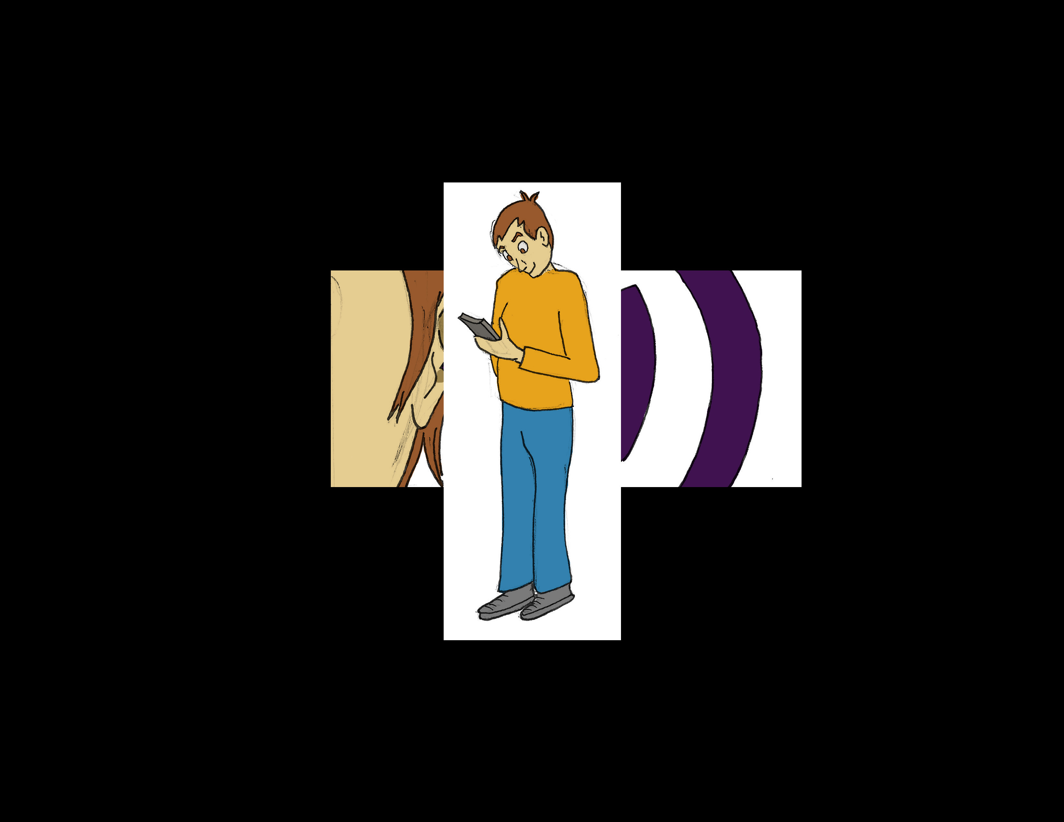
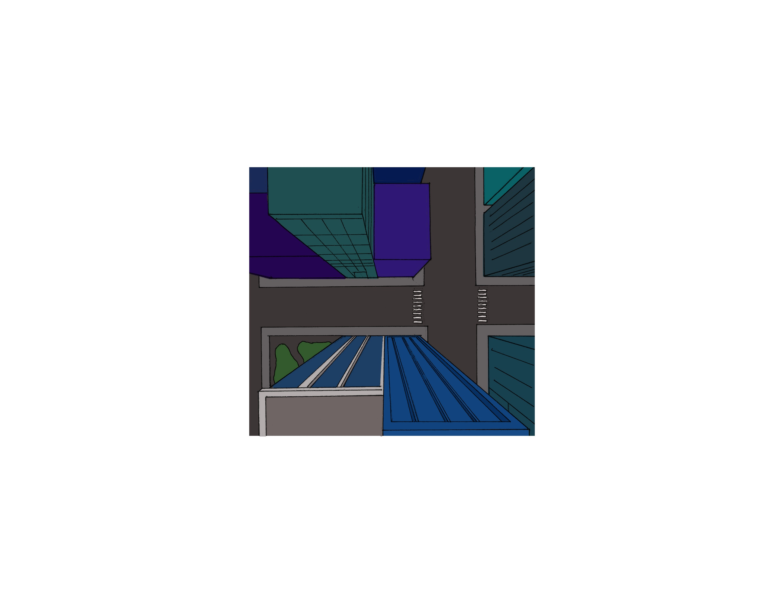
Nature signals
Mobile device translates
Human Made
Notes:
Intro: Mobile Device as translator
Some go to the user – Some go to the phone and then to the user.

Slide 13
UV Light
WiFi
IR
radiation
RAdio
Magnetic fields
Pollution
Notes:
Intro: More than we can sense
Our 5 senses – IR – UV – Magnetic Waves – WiFi – Cellphone

Slide 14
UV Light
WiFi
IR
radiation
RAdio
Magnetic fields
Pollution
Notes:
Intro: More than we can sense
Our 5 senses – IR – UV – Magnetic Waves – WiFi – Cellphone

Slide 15
Mobile devices offer connection…
Notes:
Connection and bennefits

Slide 16
Mobile devices offer connection…
… and also distraction
Notes:
Distraction and demand attention
Immersive experiences / interfaces / media

Slide 17
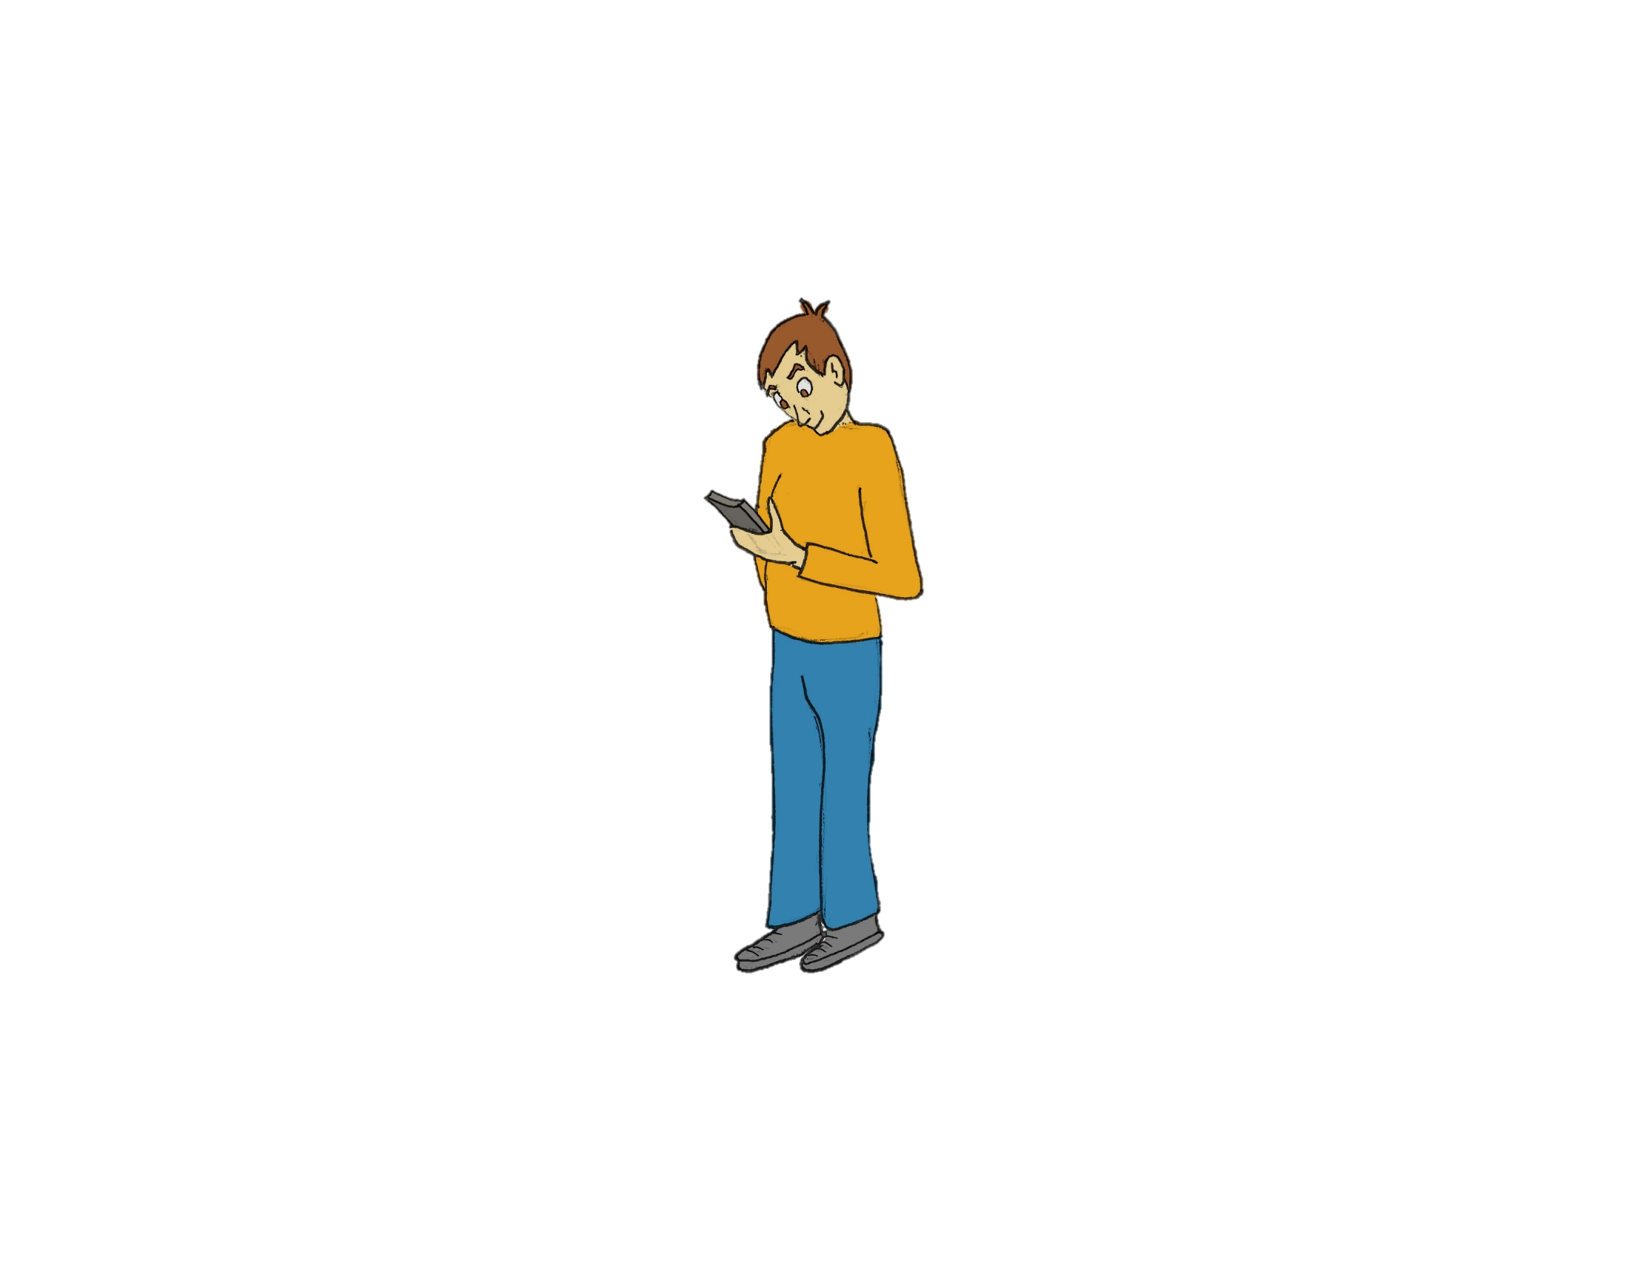
Mobile devices offer connection…
Digital synesthesia will create an immersive experience in the real world…
… and also distraction
… again!
Notes:
Intro Why!
Immersion in the real world

Slide 18
Background:
Thermal interfaces
Vibration interfaces
Mobile device interfaces
Sensory substitution
New sensory experiences

Slide 19
Background:
Thermal interfaces

Slide 20
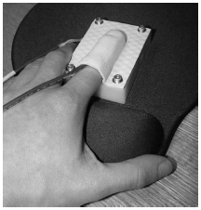
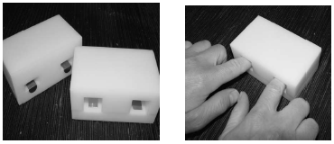
Different material are placed in the device
The pressure and temperature change of the finger was measured
The subject must identify the warmer and colder of the two
Development of thermal displays and understanding the nature of thermal cues.
“Material discrimination and thermal perception”
L. A. Jones and M. Berris
Notes:
Background: Thermal I
- Pressure on sample and relative temperature between finger an material are measured
- Two materials treated to have no recognizable textures would be inserted for the subject to identify the warmer from colder.

Slide 21
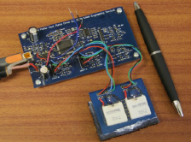
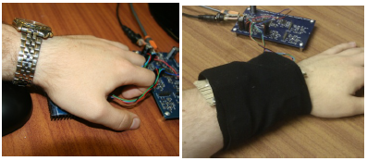
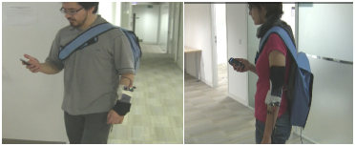
Microcontroller…
On the arm
… and Peltier
On the palm
users detect hot and cold stimuli presented to the fingertips, the palm and the arm
Two studies. One static indoor and one mobile
The experiment was repeated with the subjects walking around
“Some Like it Hot ? Thermal Feedback for Mobile Devices”
G. Wilson, M. Halvey, S. A. Brewster, and S. A. Hughes,
Notes:
Background: Thermal II
Static: Click the mouse when a change in thermal stimulation was felt. The temp of the peltier was recorded. Then rate the stimulus, “very hot” or “very cold” and “comfortable” and “very comfortable”.
Mobile: Wile walking.

Slide 22
Background:
Vibration interfaces

Slide 23
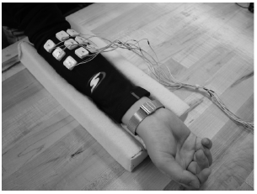
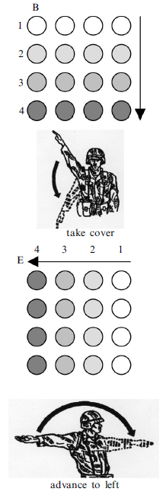
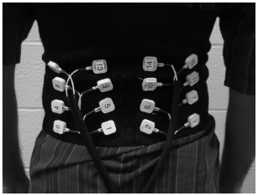
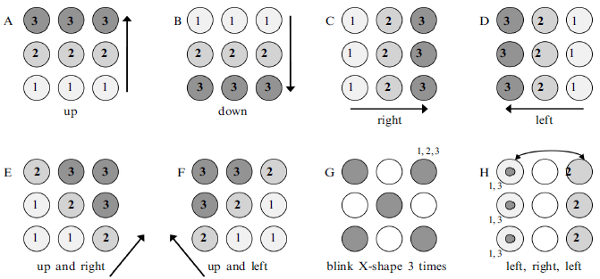
How a tactile display can communicate simple instructions and commands
On the arm
On the back
Simple patterns
Simple instructions
“Vibrotactile pattern recognition on the arm and back”
L. A. Jones, J. Kunkel, and E. Piateski
Notes:
Background: Vibration I
Participants would compare the vibration pattern with a cheat-sheet. Accuracy was different per pattern.
Compare patterns that signified hand and arm signals with the dots 98% and without 75%. Even when performing physical or cognitive tasks.

Slide 24
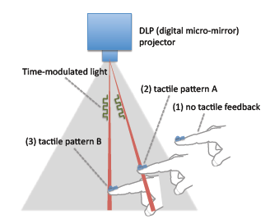
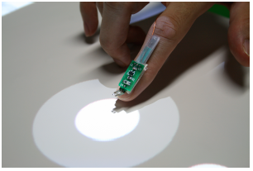
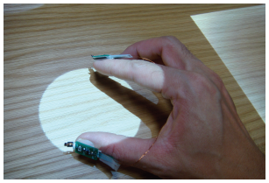
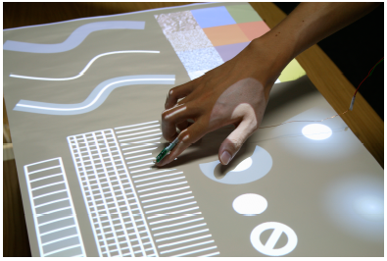
No need for positioning, the system detects structured light.
Full implementation of the system
Optical-haptic substitution
“SenseableRays: opto-haptic substitution for touch-enhanced interactive spaces”
J. Rekimoto
Notes:
Background: Vibration II
-Senseable Rays: Small and directly converts time-modulated light signals from a projector into haptic sensations.

Slide 25
Background:
Mobile device interfaces

Slide 26
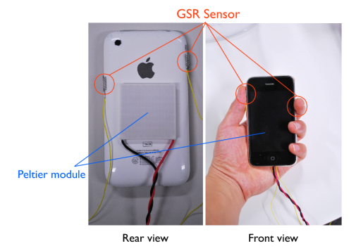
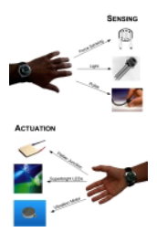
AffectPhone
Peltier delivers warmth or coolnes
detects a user’s emotional state using GSR, and conveys this state via changes in the temperature of the back panel of the other handset
Gsr sensor detects user’s emotions
“AffectPhone: A Handset Device to Present User’s Emotional State with Warmth/Coolness”
K. Iwasaki, T. Miyaki, and J. Rekimoto
connexus
Aims to detect various conditions at a time and transmit them in different ways
Detects Pressure, ambient light and heartbeat
Gives heat, light and vibration
““Connexus: a communal interface”
E. Paulos

Slide 27
Background:
Sensory Substitution

Slide 28
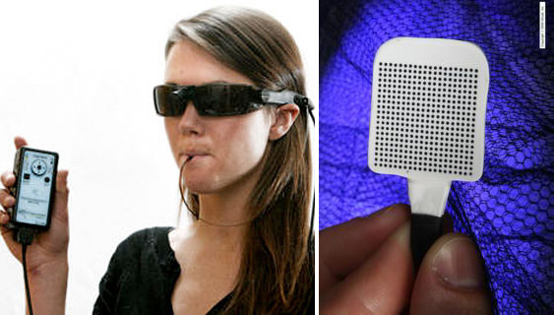
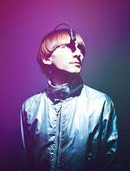
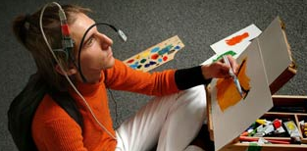
Brainport and eyeborg
Images captured by the camera…
… are translated to electrical signals in the tongue
“Brainport: an alternative input to the brain”
Y. Danilov and M. Tyler
Uses a color sensor and camera to translate…
… color information to sound
“Eyeborg”
Neil Harbisson
Notes:
Background: Sensory Substitution
-Barinport
-Eyeborg

Slide 29
Background:
Artificial sensory experiences

Slide 30
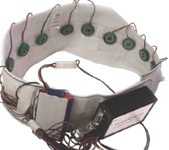
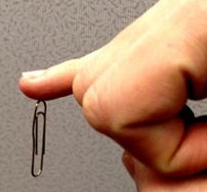
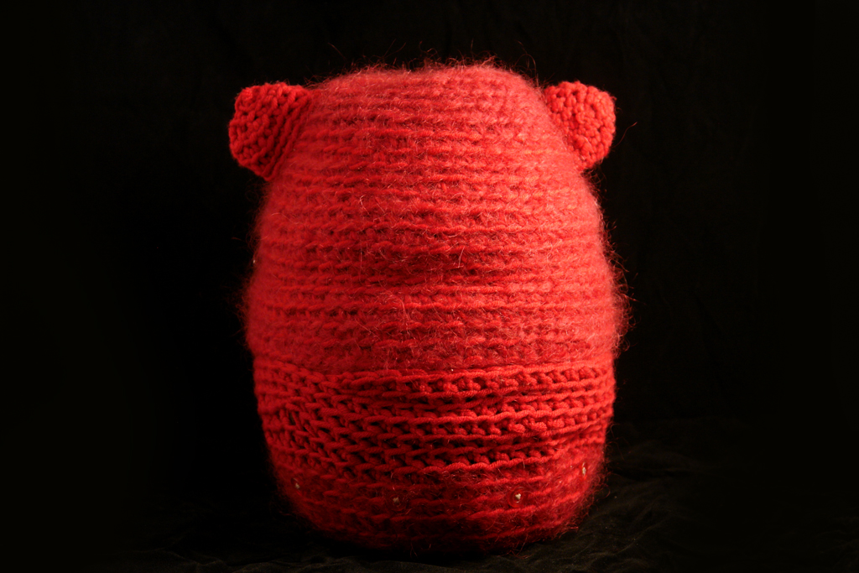
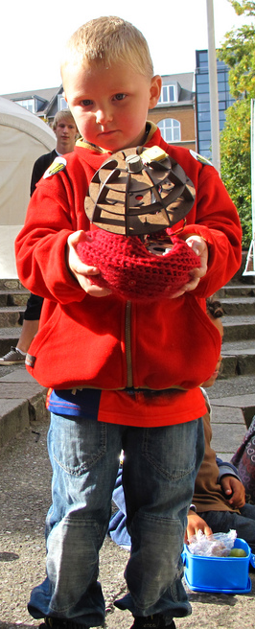
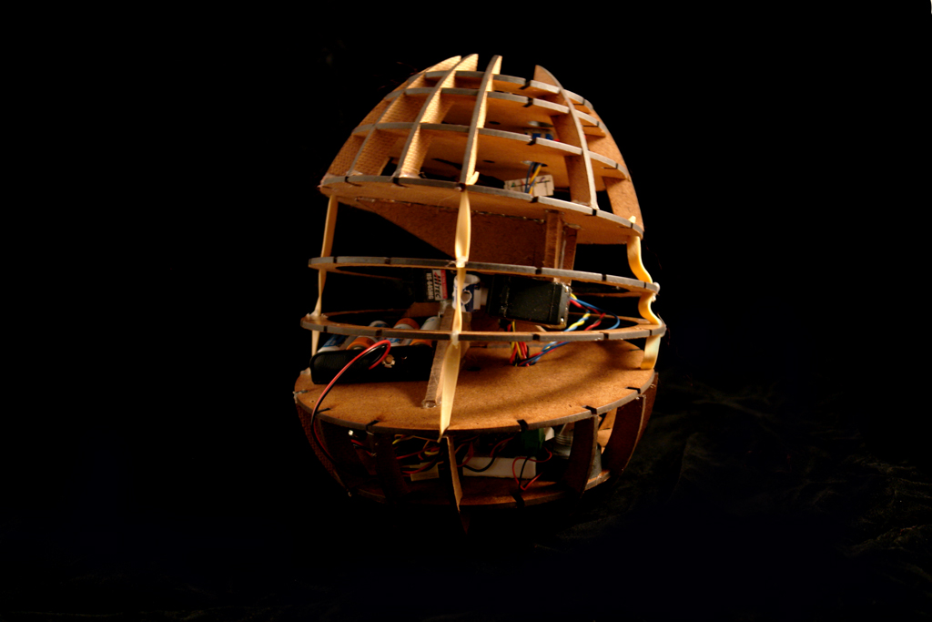
Feelspace belt, body hacking and momo
“feelSpace Belt”
Nagel, S. K., Carl, C., Kringe, T., Märtin, R., & König, P.
“Body Hacking: My Magnetic Implant”
D. Berg
“MOMO: a haptic navigation device”
C. WANG and K. O’FRIEL
Notes:
Baground: new Senses
FeelSpace Belt
Implanted magnets
Momo

Slide 31
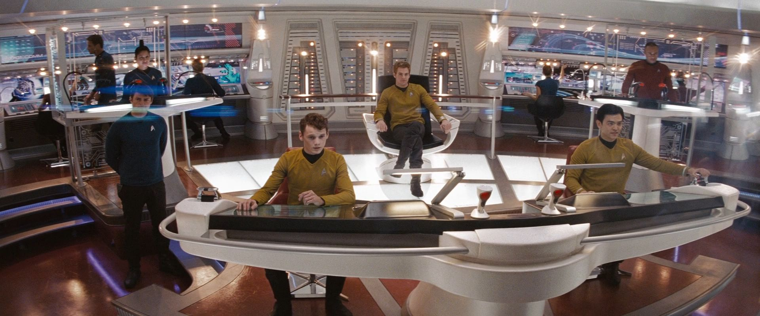
Situational awareness
Take information from the environment, integrate it with previous knowledge and form a coherent mental picture
Notes:
Background: Interfaces
Situational Awareness

Slide 32
neuroplasticity
The ability of the brain to assimilate new input
Notes:
Background: Interfaces
Situational Awareness

Slide 33
Digital Synesthesia

Slide 34



Skin’s light sensitivity to find a tall grass
Sense victim through smell
Jump and hopefully land on animal
The tick understands only three signs
Smell
Temperature
hairiness
Find bald spot and feast
“a foray into the Worlds of Animals and humans”
Jakob von Uexküll
Notes:
Digital synesthesia
Semantic sensory theory
Sensory data as signs
umwelt as the perceptual world in which an organism exists and acts as a subject

Slide 35


Bees can use uv light to pick flowers
Hammer-head sharks hunt sensing electric signals from the muscles of prey
Notes:
Nth Sense:
The things we could do if we could sense new information?
How would our world perception change?

Slide 36

Bees can use uv light to pick flowers
Hammer-head sharks hunt sensing electric signals from the muscles of prey
Notes:
Nth Sense:
The things we could do if we could sense new information?
How would our world perception change?

Slide 37

Cognitive load
When by-passing the visual sense, it is easier for the brain to interpret information without shifting attention from current task
Notes:
Background: Interfaces
Situational Awareness

Slide 38


We all feel the same conditions in a different way
Notes:
Get away from teh universal value and bring the personalized feeling

Slide 39
User Studies
i Proximity sensing:
Artificial experience with High redundancy
ii Temperature sensing:
Artificial sensory experience with no redundancy
iii Mobile sensors:
Artificial sensory experience with unknown context

Slide 40








A proximity sensor and a vibrator
sensor
User study i:
proximity
vibrator
The task was done 3 times. With Bars, flat shapes and volumes.
The user is asked to identify the number and shapes of the objects on the table
Notes:
Important to stablish a base line and to test also vibration and temperature

Slide 41




Results phase one
Users had to identify the number of bars on the table from 0 to 3

Slide 42




Results and evaluation Phase two

Slide 43



Results and evaluation phase three

Slide 44



Research plan, stage ii
Head Band
Outward IR sensors on the forehead
Inward transducers
Set up a group activity
User will have an advantage
Detecting the stress level of the others

Slide 45
Research questions, stage ii
New senses?
How does the user perform when having access to a new sense?
New stimuli?
How accurate is the digital sense in the context?
Sense substitution?
Can this artificial sense replace an existing sense for the given activity?
Is there a phantom sense feeling?
Is there a difference depending on the user’s familiarity with the task?

Slide 46



Research plan, stage iii
Neck
Peltier device responds to location…
With the glass infrastructure
Interact with the lab
Use doppellab to interact with the user

Slide 47
Research questions, stage iii
Human development?
When learning a new sense, are children better at it than adults?
New stimuli?
How fast to users understand the new stimuli?
Does it depend on the activity or the feedback?

Slide 48


Research plan, stage iv
Design thinking
… to tree
From Sapling…

Slide 49
Research questions, stage iv
Escaping the visual interface?
Can this artificial sense replace an existing sense for the given activity?
Design thinking?
Can a pattern be identified to generalize a digital synesthesia design process?

Slide 50
timeline
PHASE ONE (JANUARY - march)
This stage is dealing with the final contexts that will be developed to prove my thesis as well as getting the proposal submitted and approved by MASCOM and defended.
This is the development stage. Fabrication and initial testing of the devices
PHASE TWO (march - APRIL)
Final testing will be made of each of the systems for the contexts chosen. Extra attention will be put on the mobility of the system and its future deployment outside the lab. User testing on the first stage will begin.
PHASE THREE (MAY - JUNE)
User Testing will be done for the second and third stages.
PHASE FOUR (JULY - AUGUST)
Thesis writing and defense.

Slide 51
conclusions
Escaping the visual interface?
Can this artificial sense replace an existing sense for the given activity?
Design thinking?
Can a pattern be identified to generalize a digital synesthesia design process?

Slide 52
The end
Thank you…
Questions?

